Slide 1
Progress Report 8
Sprint 8 - (4/2 - 4/16)
Brian Goughnour, Josh Brown, Steve Stamey, Guylain Kibunzi, Chauncey Davidson

Slide 2
Map
Goals
The user can navigate and traverse the map freely
The user can enter in an address and jump to that location
The user can select an address and add it to their list of addresses and locations (into the database)
The user can view their marked locations
Technologies
HTML
Javascript
Leaflet Methods/Imports
Iceboxed
Search Bar plugins, Accurate Geocoding, Map Load Bugs, cleaned up event passing

Slide 3
Goal Tracker
Goals
The user can create a new goal.
The newly created goal will be put into a list and go to the top.
The user can update the list as goals are completed.
A created goal can be removed from the list.
The submodule can accept new goals from other subsystems
Technologies
HTML
Javascript
CSS
Meteor
Mongo DB
Cordova for iOS translation

Slide 4
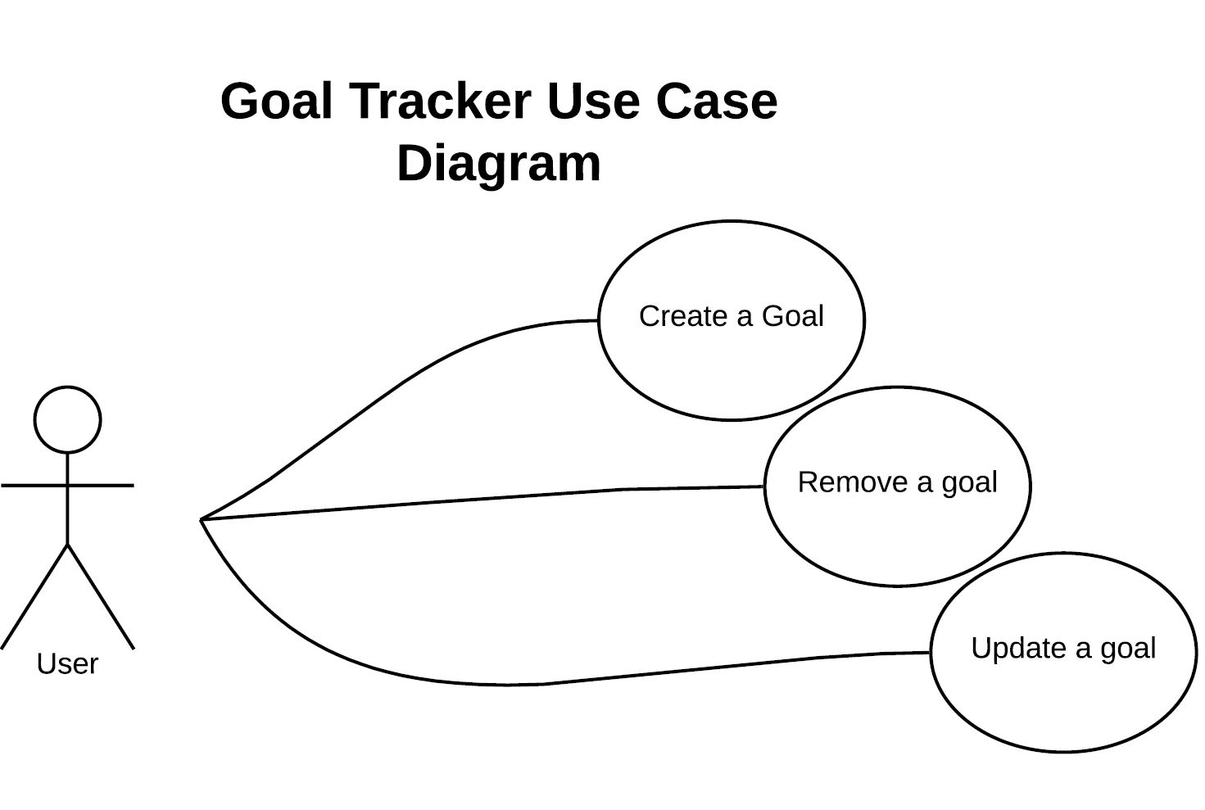
Goal Tracker Use Case Diagram

Slide 5
Education
http://localhost:3000/
http://localhost:3000/
Goals
Provide education and resources to assist and support users.
Provide information about online course, course calendar, and certificates.
Educate community members about health career choices and recruit future professionals.
Provide user with information about clinical training experience.
Technologies
HTML
Javascript
CSS
Cordova
Meteor

Slide 6
Hot Dial
Independent module
Quick calls saved in local database
Add/Remove Numbers
Frameworks/Libraries:
Cordova plugin for calling via Android and iOS
Javascript backend
HTML frontend with Bootstrap/CSS for styling

Slide 7
Calendar
Connected with Goaltracker
Future connection with Map
Frameworks/Libraries:
Cordova plugin for communication to native calendar
Javascript backend
HTML frontend with Bootstrap/CSS for styling

Slide 8
Settings
Goals
To allow users to customize app
Allow users to change the functionality and behavior of the application
Give users an option to create a profile; strengthening the bond within our community
Technologies
Languages
Javascript
HTML / CSS
Frameworks
Meteor - open source platform for mobile
Cordova - container for running apps on mobile
Libraries/ packages
NPM - touted as the world’s largest software registry
MongoDB - cross-platform database

Slide 9
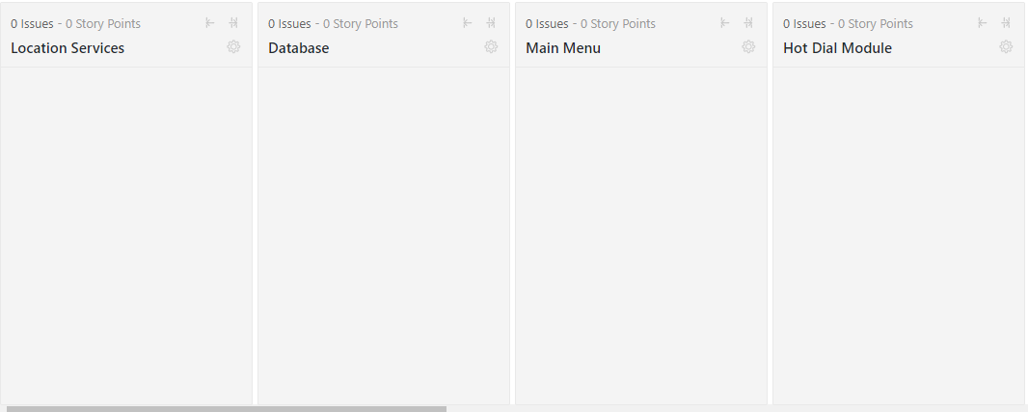
ZENHUB

Slide 10
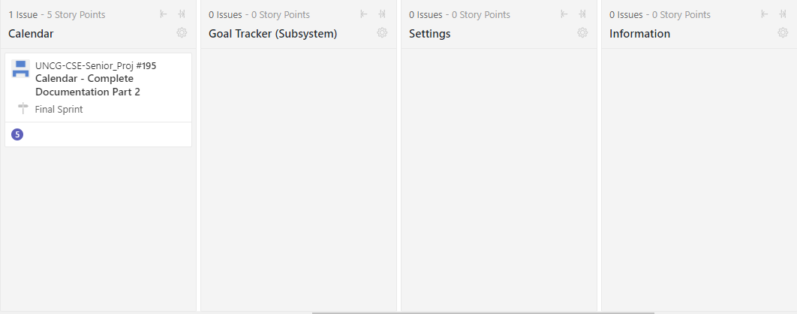
ZENHUB

